Slide 1
Large-Scale and Multi-Structured Databases Project Design Reviook
Arancio Febbo Salvatore
Di Donato Mattia
Giorgi Matteo

Slide 2
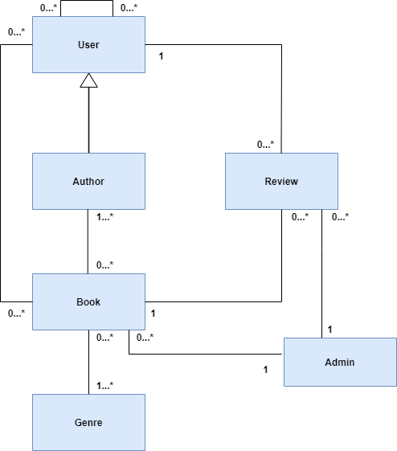
UML Class Diagram

Slide 3
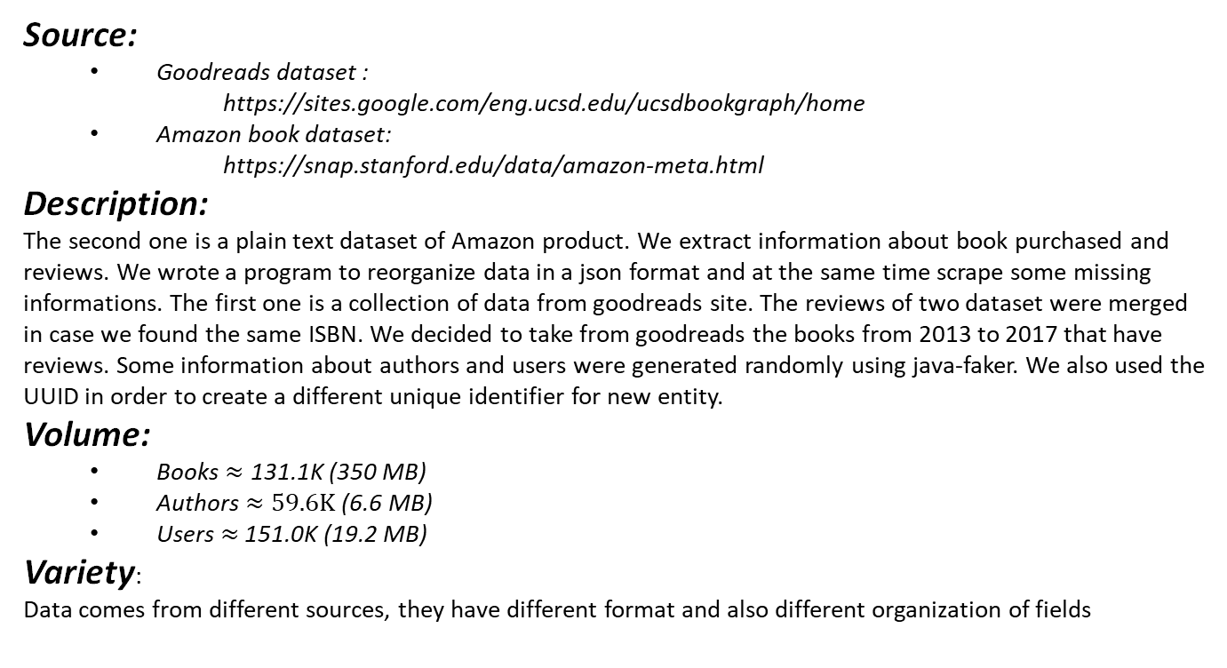
Dataset Description
Source:
Goodreads dataset :
https://sites.google.com/eng.ucsd.edu/ucsdbookgraph/home
Amazon book dataset:
https://snap.stanford.edu/data/amazon-meta.html
Description:
The second one is a plain text dataset of Amazon product. We extract information about book purchased and reviews. We wrote a program to reorganize data in a json format and at the same time scrape some missing informations. The first one is a collection of data from goodreads site. The reviews of two dataset were merged in case we found the same ISBN. We decided to take from goodreads the books from 2013 to 2017 that have reviews. Some information about authors and users were generated randomly using java-faker. We also used the UUID in order to create a different unique identifier for new entity.
Volume:
Books $≈\text{1}\text{31.1}\text{K}$ (350 MB)
Authors $≈59.6K$ (6.6 MB)
Users $≈$ 151.0K (19.2 MB)
Variety:
Data comes from different sources, they have different format and also different organization of fields

Slide 4
Dataset Description
User document
Book document
Author document

Slide 5
Non-Functional Requirements
The application should be simple, intuitive and fast in response.
The password must be protected and stored in an encrypted form and must be between 8-20 characters.
The user’s and author’s username must be unique.
The application should store locally information to reduce network traffic and DBs load.
Data may not be updated for up to 10 minutes
The code must be easy to maintain.

Slide 6
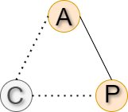
CAP
The application is oriented on A (Availability) ,P(partition Protection) edge of the CAP triangle. The application wants to offer high availability of the content, even if an error occurs on the network layer, at the cost of returning, to the users, data which is not always accurate.
High Availabitilty of the service due to the way we handle write operation. In fact, after receiving a write operation we wait until one server will be updated, and the other replicas will be eventually updated. In this way writes operation don’t keep the server busy for too much time.
Partition Protection of the service is guarantee by the presence of replicas in our cluster, if one server is down, we can continue to offer our service by searching the content in the replicas.

Slide 7
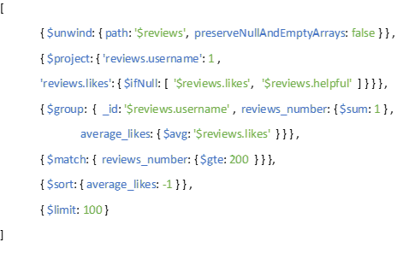
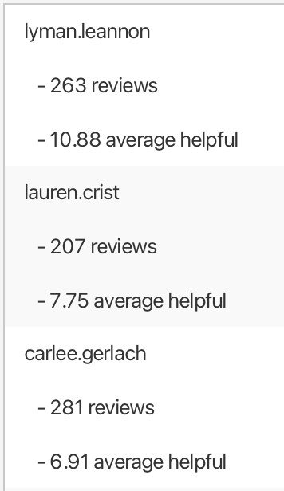
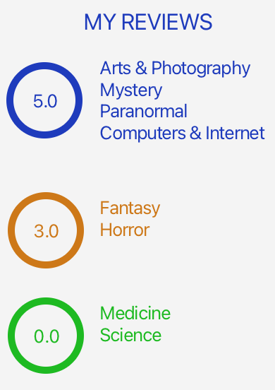
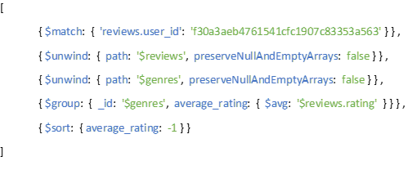
Analytics

Slide 8
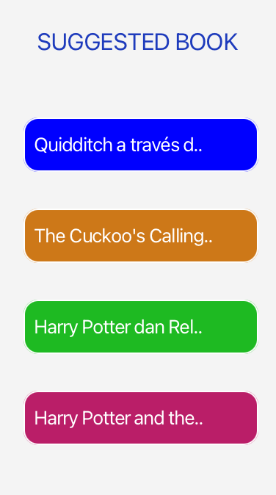
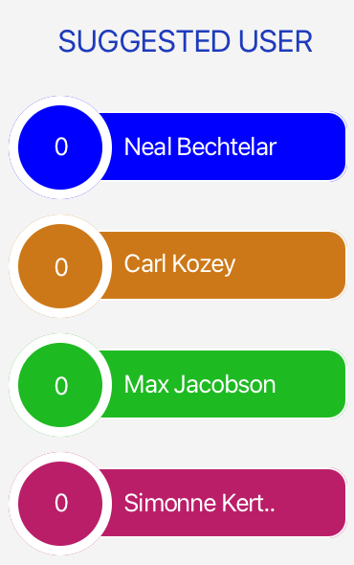
Suggestions
OPTIONAL MATCH (u1:"myType"{username:' myUsername'})-[:READ|:TO_READ]->(b:Book)
WITH collect(b) as readings
MATCH (b1:Book)<-[:WROTE]-(a:Author)-[:WROTE]->(b2:Book)
WHERE b1.id = 'book_id' AND b1<>b2
AND NOT b2 IN readings
RETURN DISTINCT b2.id,b2.title
MATCH (u:"myType"{username:'myUsername'})
OPTIONAL MATCH (u)-[:FOLLOW]->(f:User)
WITH u, collect(f) as followed
MATCH (u1:"type"{username:'username'})-[:READ|:TO_READ]->(b:Book)<-[]-(u2:User)
WHERE u1<>u2 AND u<>u2
AND NOT u2 IN followed
RETURN DISTINCT u2.id,u2.name,u2.username

Slide 9
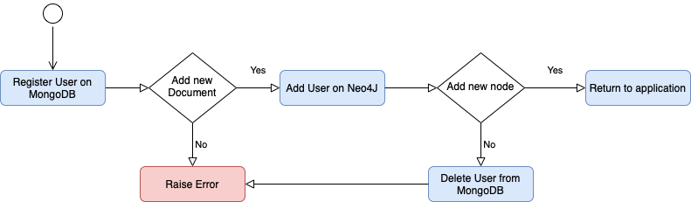
Data Consistency
We maintain the consistency of the two Databases for all the Creations and Deletions of Users/Authors/Books/Follows.
The way we manage this, is similar to the Add New Users/Authors

Slide 10
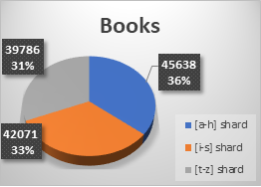
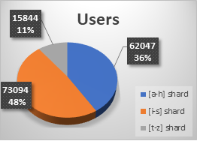
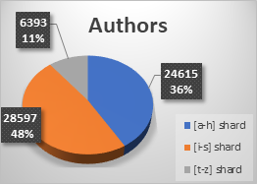
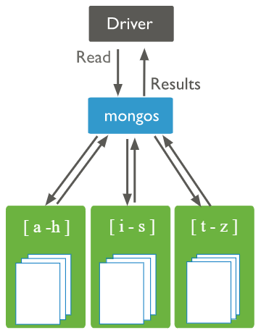
Sharding
Range Based Strategy
3 shards for Books, Users and Authors collections
3 replica set for each shard

Slide 11

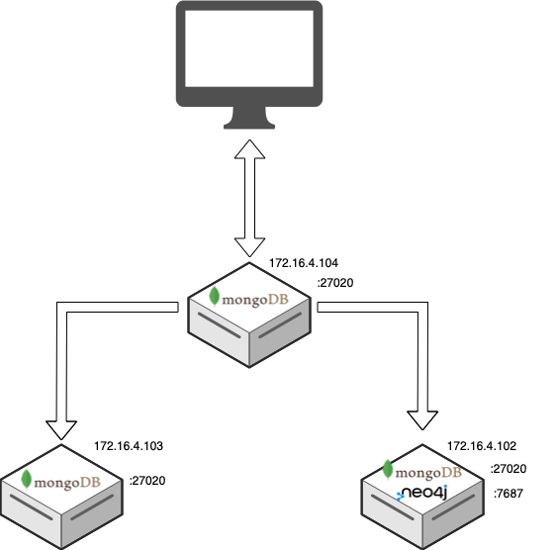
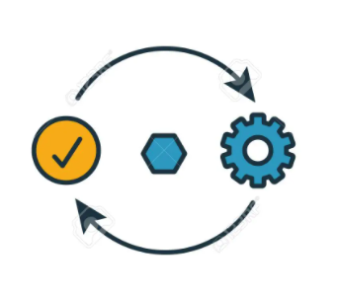

Software & Hardware Architecture
Package Components
Package Entity
GUI
Application
Package Controllers
Cluster
Package Manager

Slide 12
Final considerations
INDEX: The application is read heavy, so we introduced index to speed up the most frequent queries.
CACHE: To avoid querying the database too many times a cache has been implemented.
Our application: https://github.com/mattiadido95/Reviook

